Slide 1

CAR PRICE PREDICTION
FLIPROBO TECHNOLOGY
BY: ARGHA KR MAITI
January
2022

Slide 2

ACKNOWLEDGMENT
I would like to express my thanks of gratitude to mentors SWATI MAHASETH as well as FLIP ROBO who gave me the golden opportunity to do this wonderful project on the topic Car Price Prediction Project, which also helped me in doing a lot of research and I came to know about so many new things. I am really very thankful to them. I am making this project to increase my knowledge.

Slide 3

INTRODUCTION
PROBLEM STATEMENT:
With the covid 19 impact in the market, we have seen lot of changes in the car market. Now some cars are in demand hence making them costly and some are not in demand hence cheaper. One of our clients works with small traders, who sell used cars. With the change in market due to covid 19 impact, our client is facing problems with their previous car price valuation machine learning models. So, they are looking for new machine learning models from new data. We have to make car price valuation model.
This project consists on of 2 phases:

Slide 4

DATA COLLECTION PHASE:
We need to scrape approx 5000 used cars data.
In this section we need to scrape the data of used cars from websites. We need web scraping for this. we have to fetch data for different locations. The number of columns for data doesn’t have limit. Generally, these columns are Brand, model, variant, manufacturing year, driven kilometers, fuel, number of owners, location and at last target variable Price of the car. This data is to give you a hint about important variables in used car model.

Slide 5
MODEL BUILDING PHASE:
After collecting the data, you need to build a machine learning model. Before model building do all data pre-processing steps. Try different models with different hyper parameters and select the best model.

Slide 6

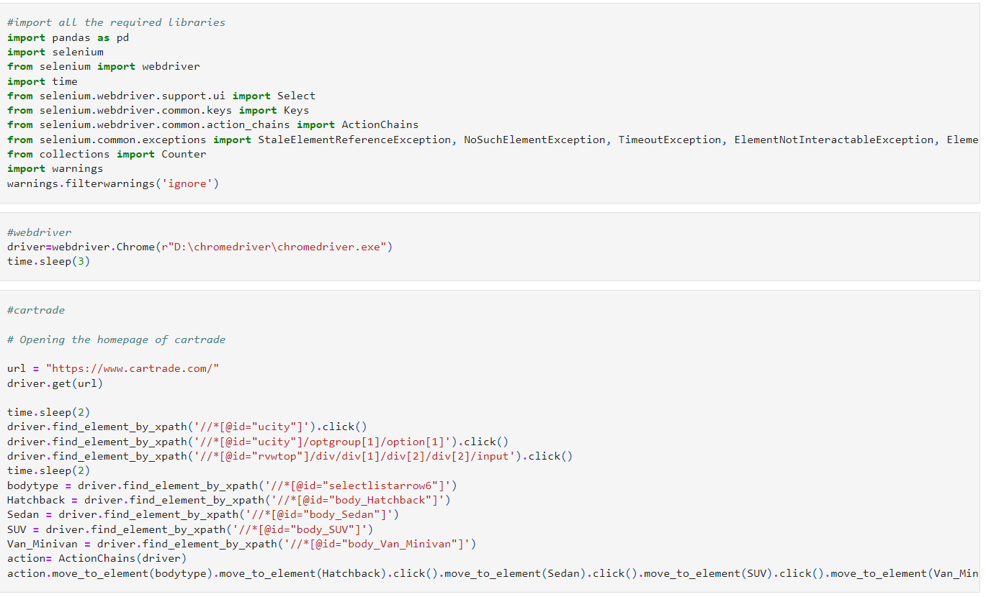
Analytical Problem Framing
With the help of Selenium I have scrapped data from different websites like cartrade, Olx and carwale and used Pandas library to save the data in excel file and csv file. Just taking a glace on basic code for scrapping from different websites.

Slide 7
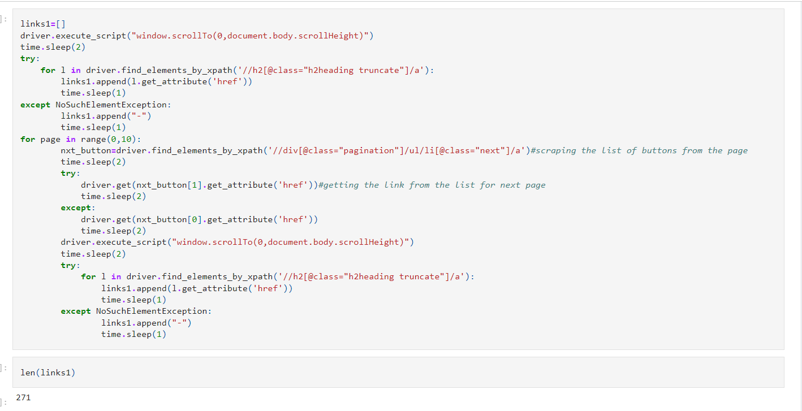
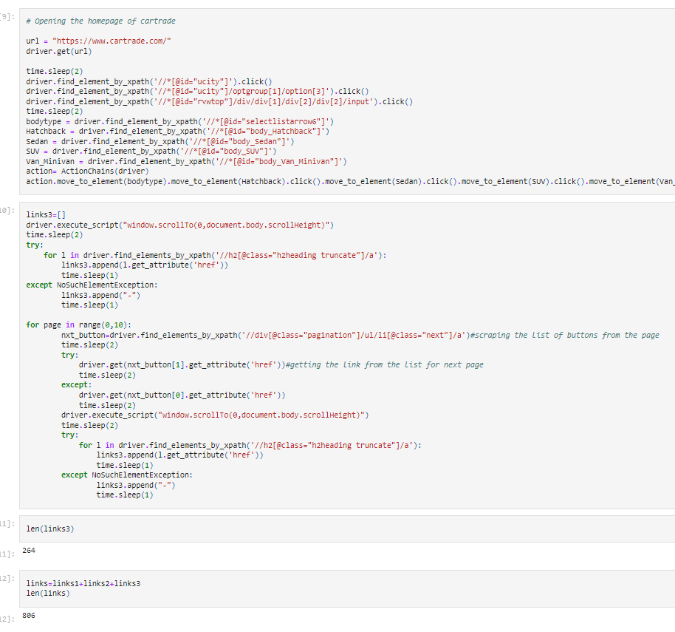

Slide 8
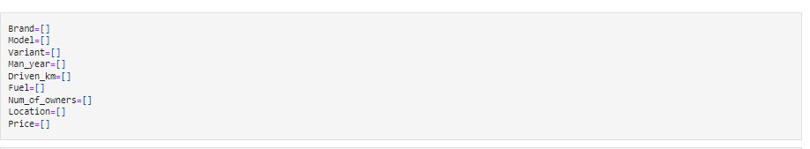
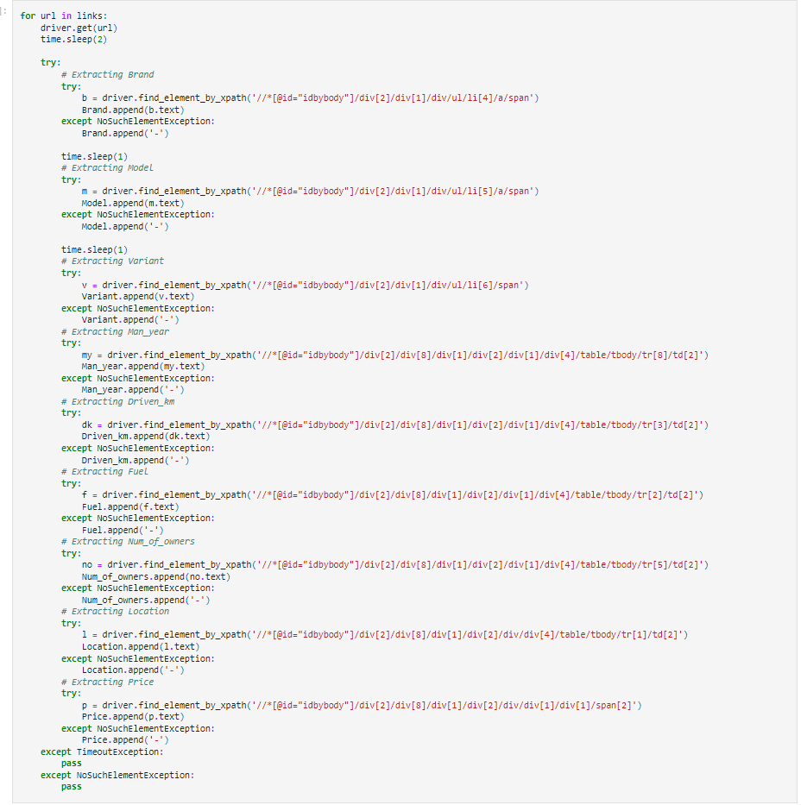
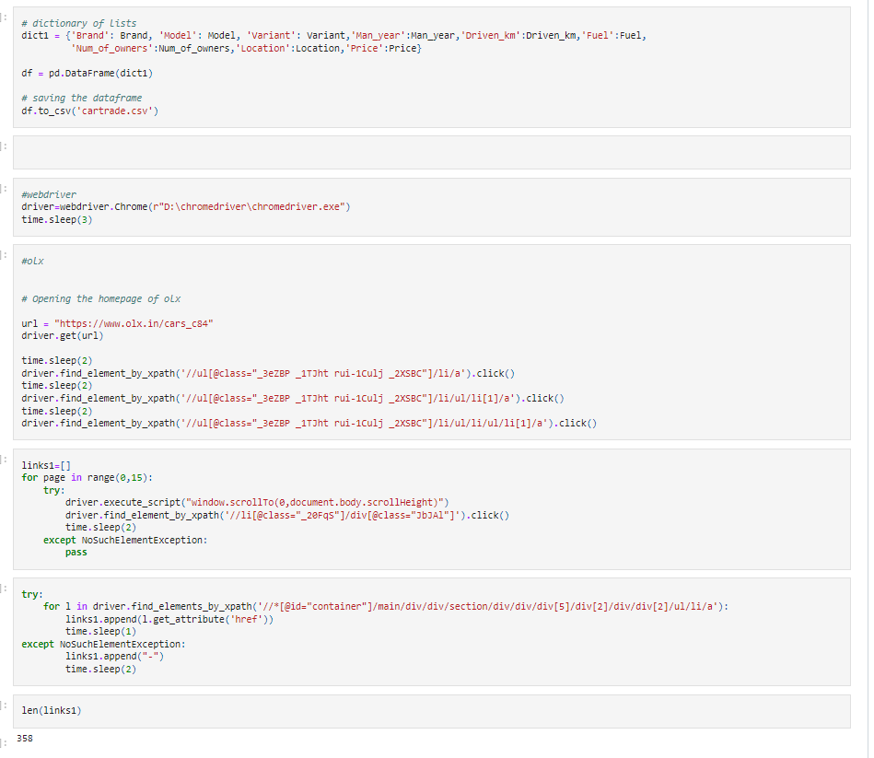

Slide 9
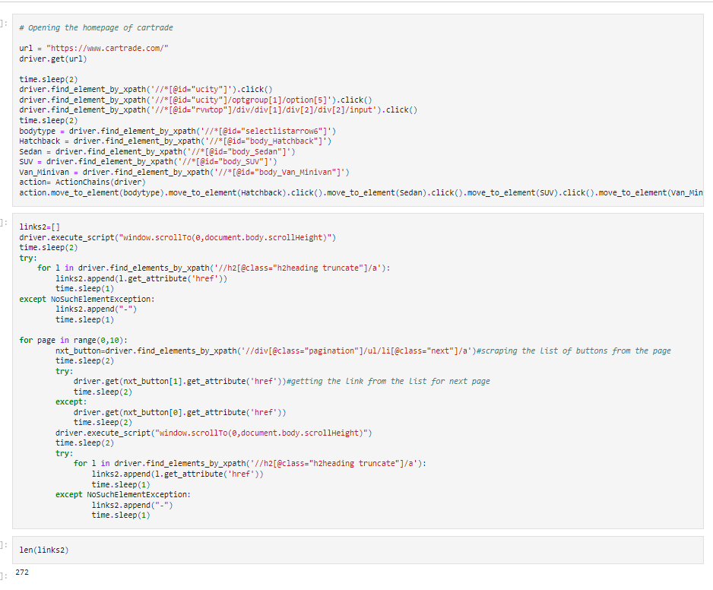


Slide 10
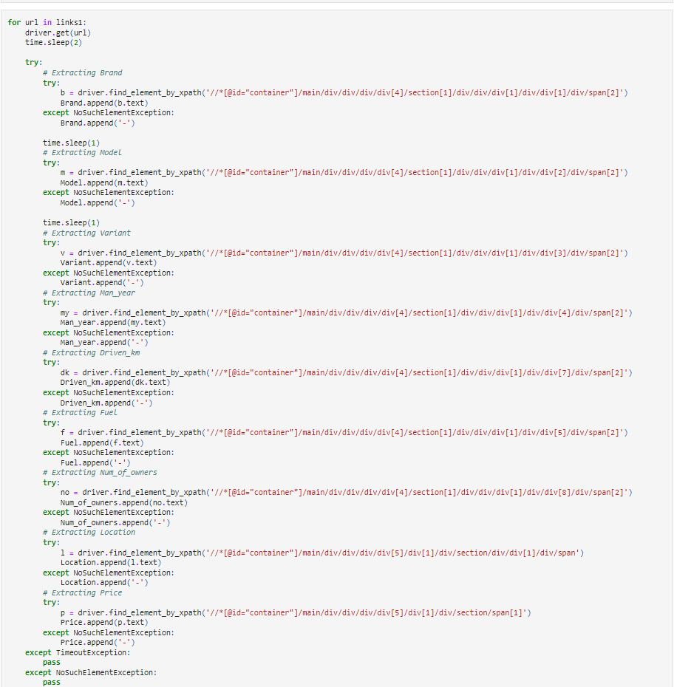
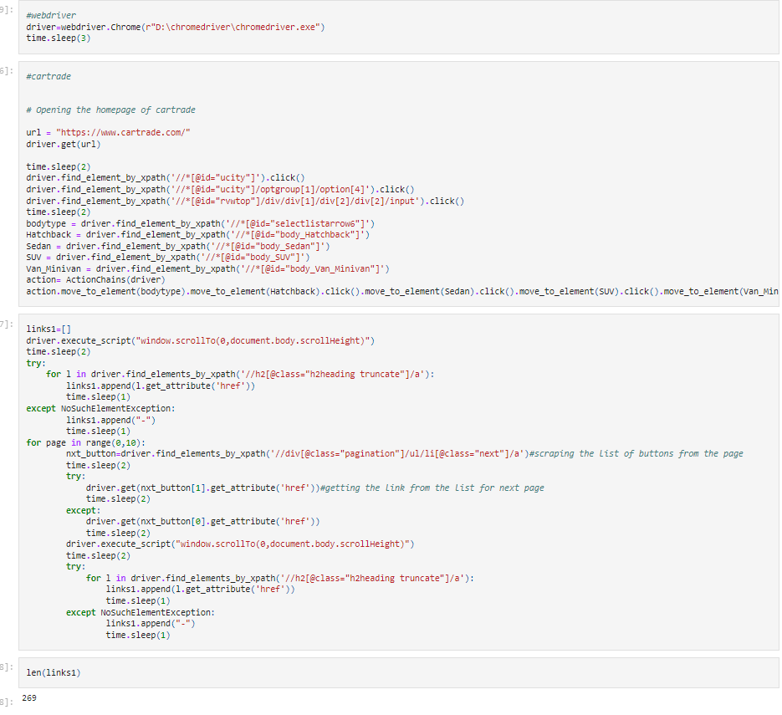

Slide 11
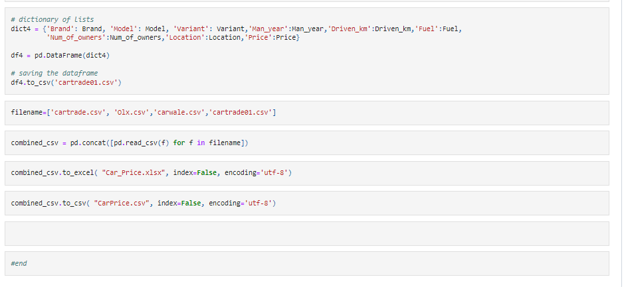

Slide 12
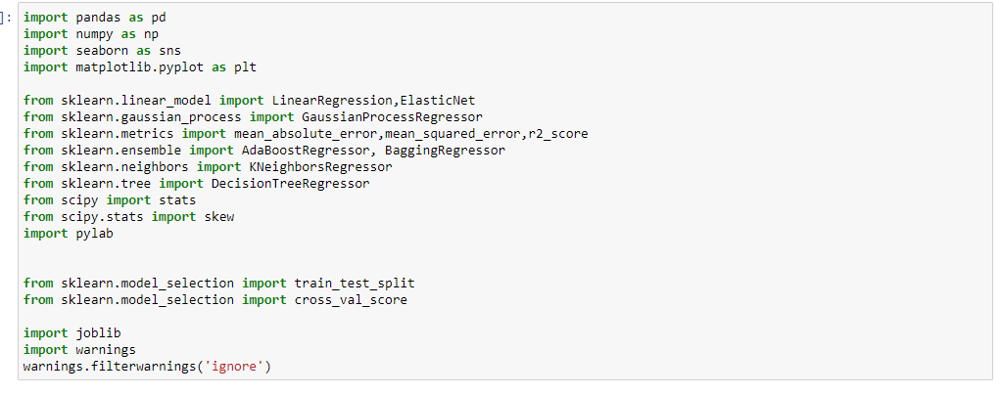
Firstly, we will start by importing required libraries and databases.

Slide 13
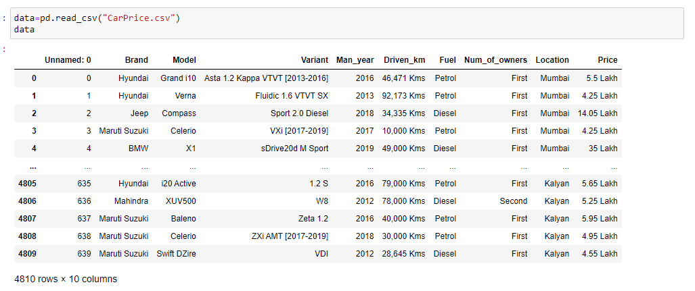
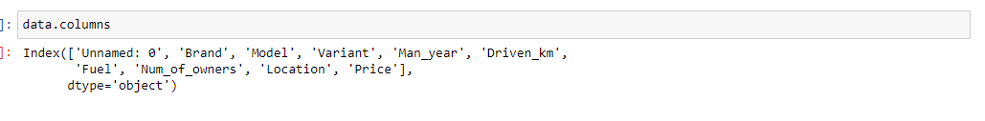
Now Load the datasets carprice.csv file.

Slide 14
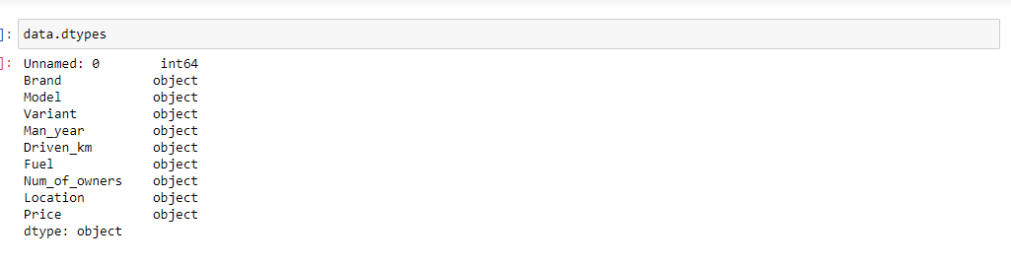
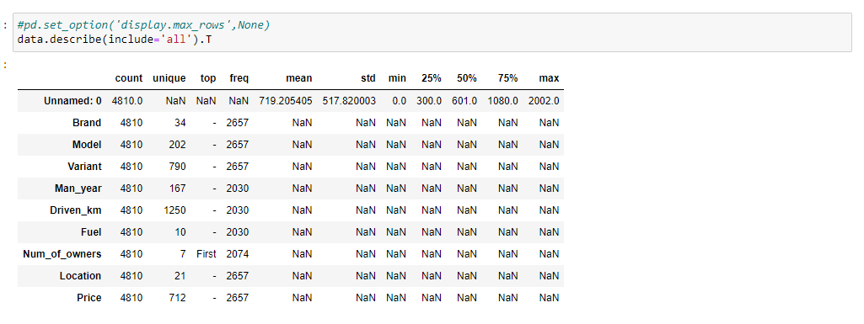
Above is the list of all columns in our datasets.
Our datasets has 4810 rows and 10 columns .
We can see both type of columns numerical and object type.

Slide 15
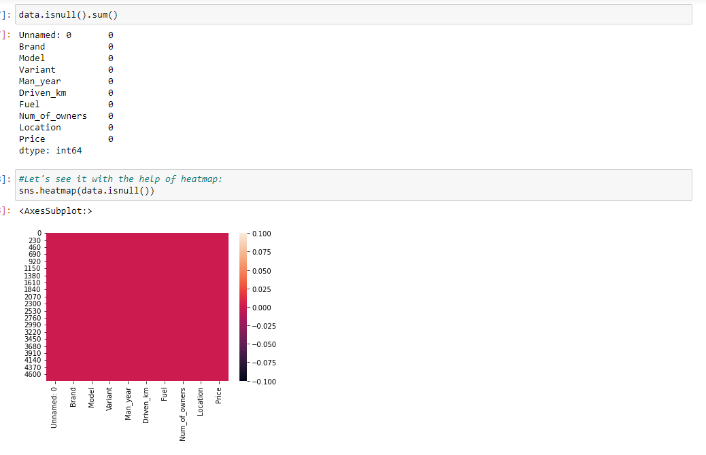
We can see - in some variables most frequently value. We will work on it.
We can see count is all same for all variable, let's check for null values now:
Our datasets does not contain any null values.

Slide 16
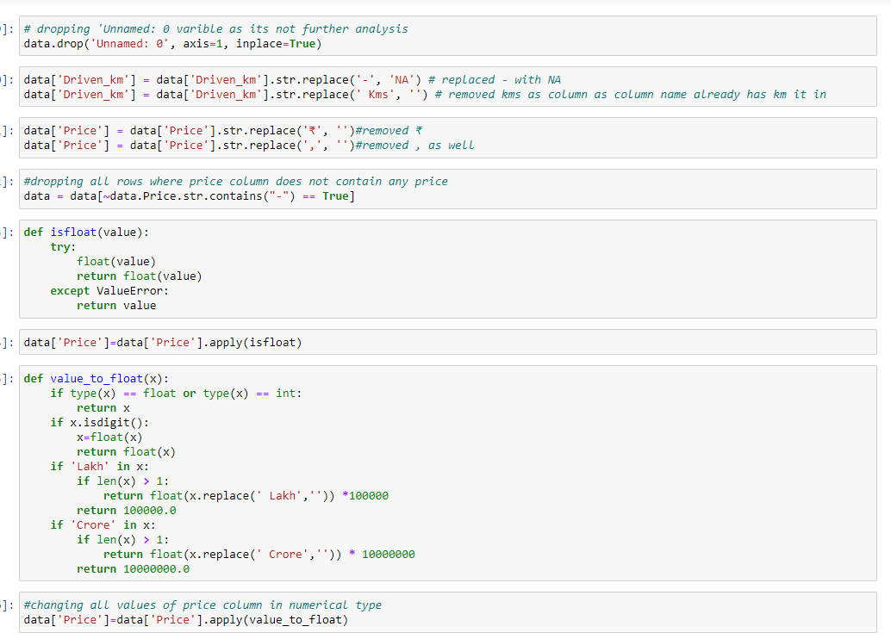

Slide 17
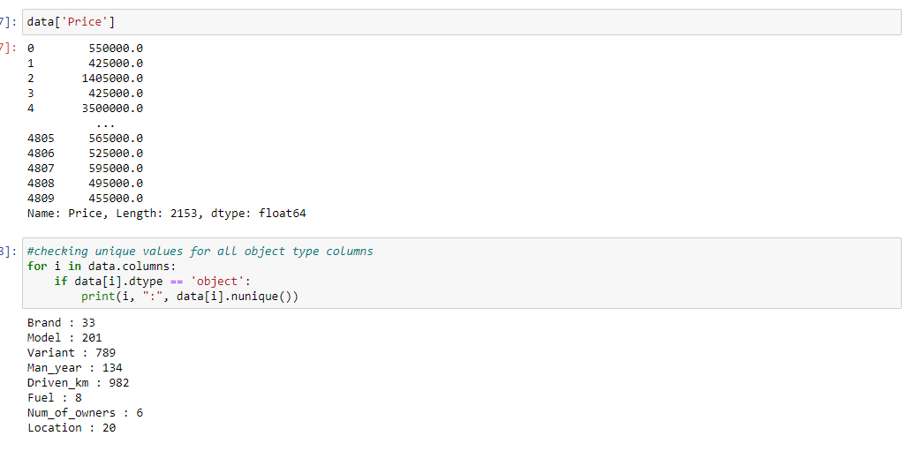
we can see manufacturing year has 134,,

Slide 18
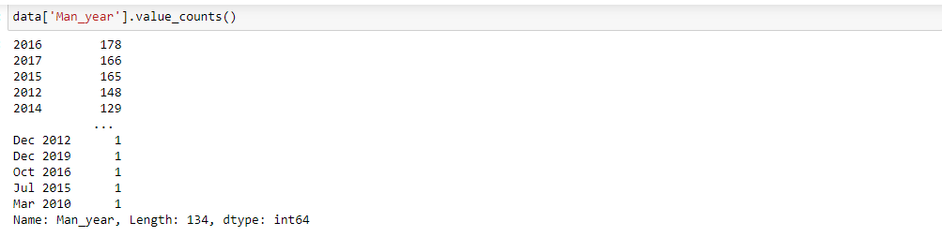
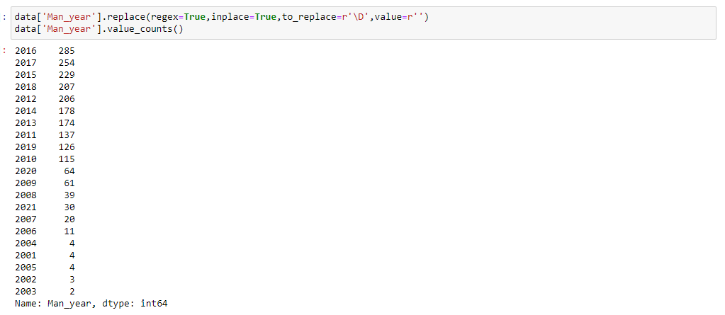
some values contain month as well. Let's remove months and only keep year.

Slide 19
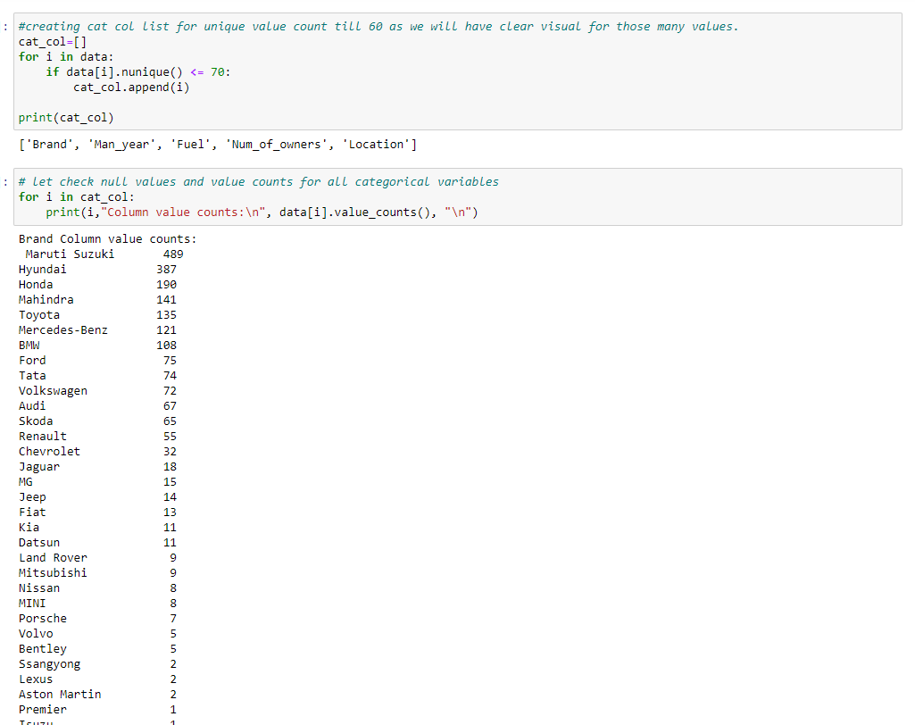

Slide 20
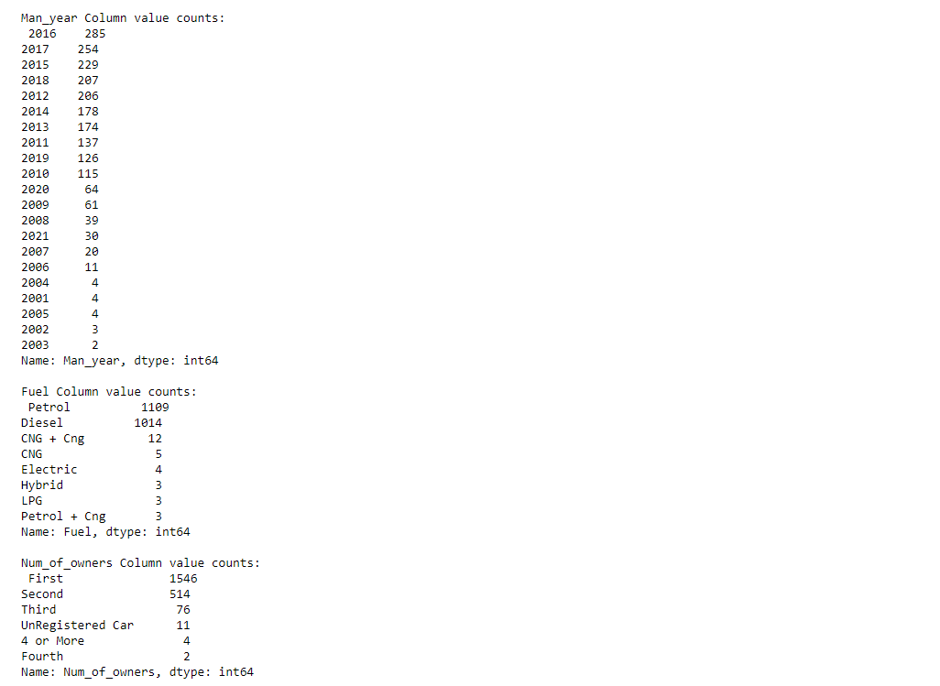

Slide 21
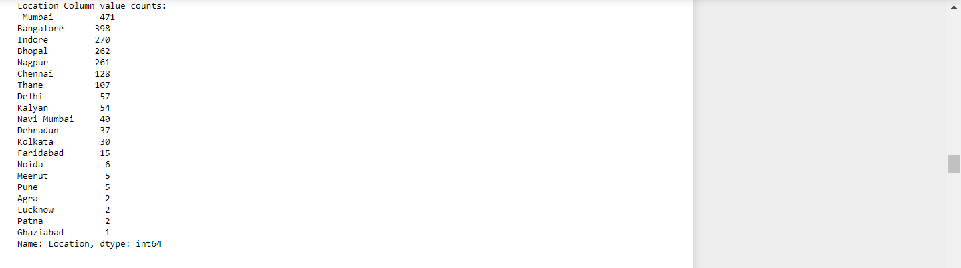
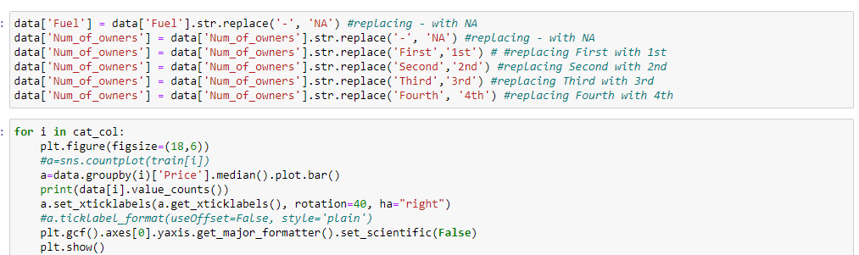
Fuel variable has - value in it. And Number of owners has same value with different format. let’s make required changes.

Slide 22
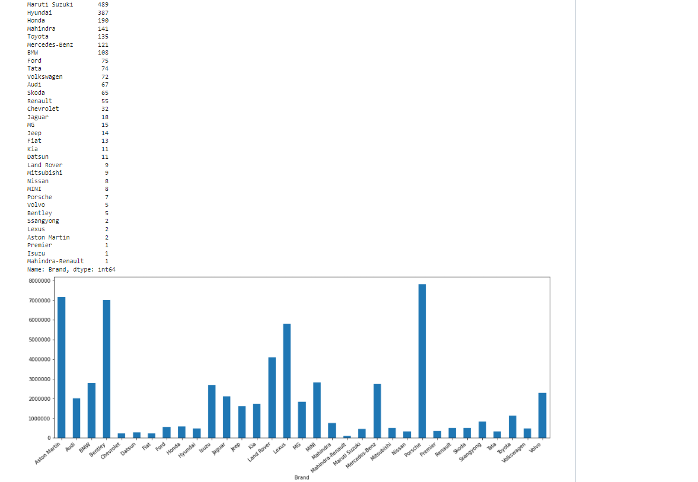

Slide 23
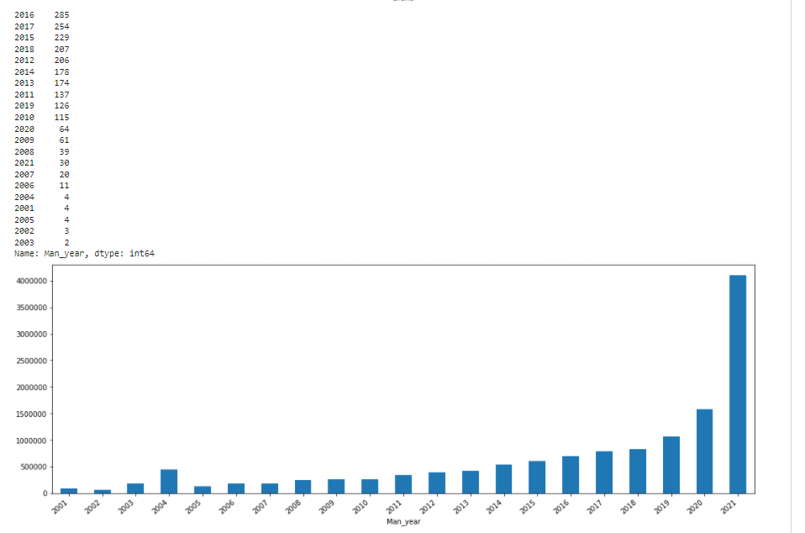

Slide 24
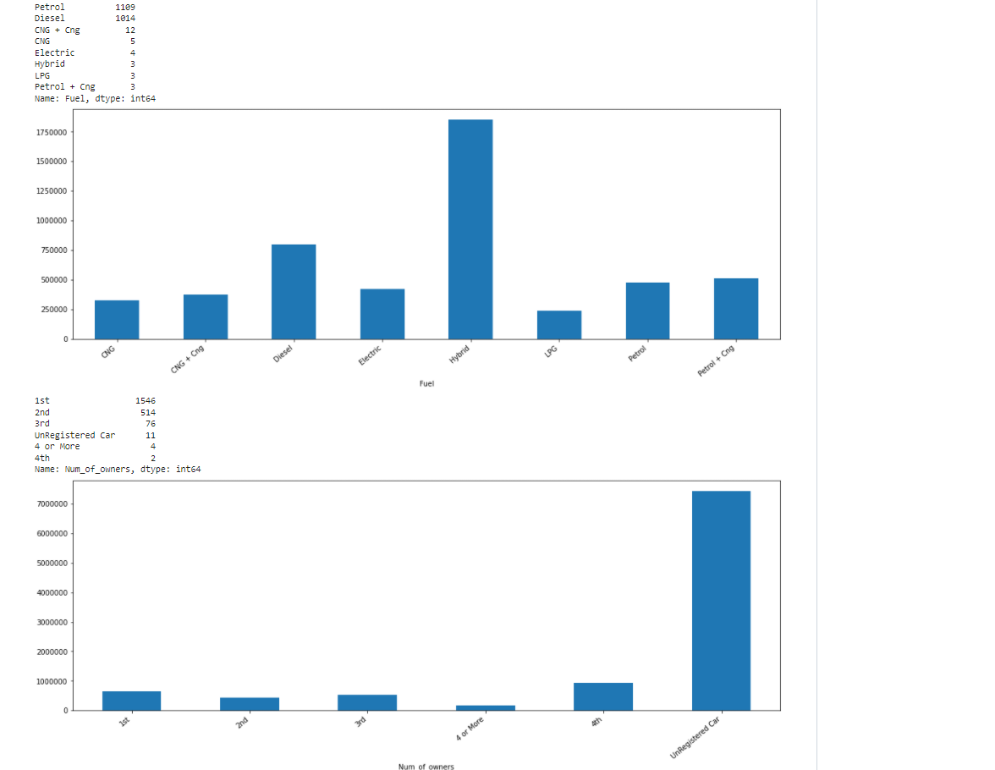

Slide 25
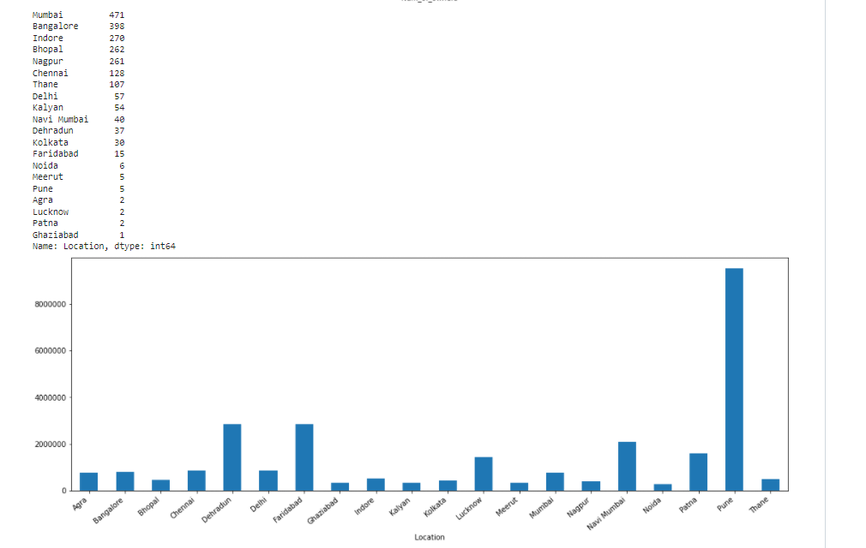
Highest price is for Porsche and maximum count is for Maruti Suzuki and then Hyundai.
Highest price is for manufacturing year 2021, maximum count is for year 2016 and 2017.
Highest price is for hybrid type of fuel; maximum count is for vehicle with fuel type petrol and Diesel.
With respect to number of owners highest price is for Unregistered Car and maximum count is for 1st.

Slide 26
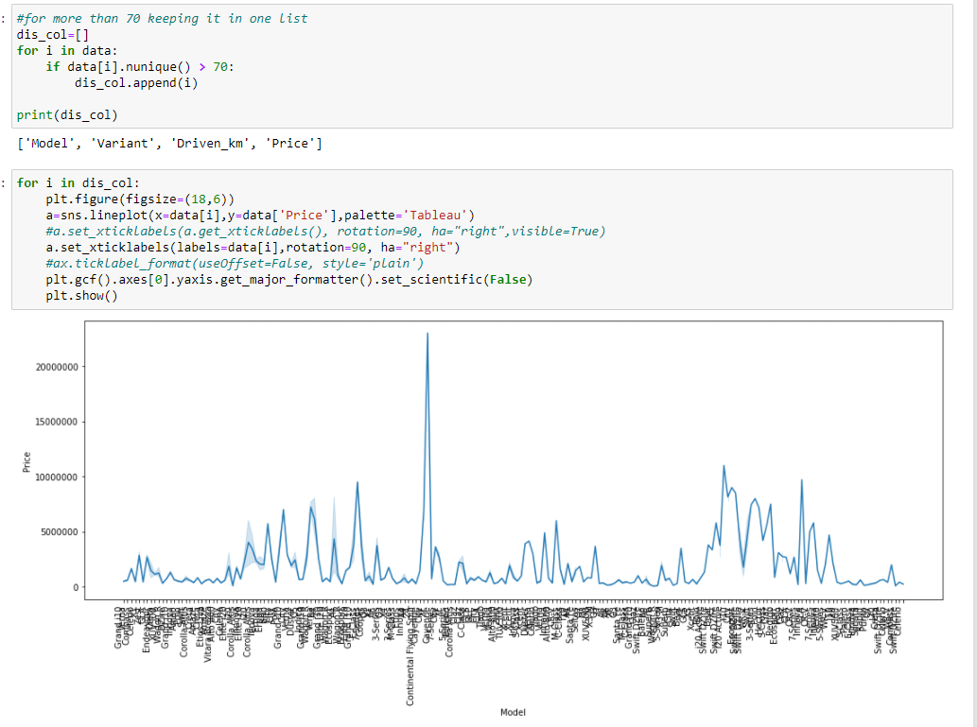

Slide 27
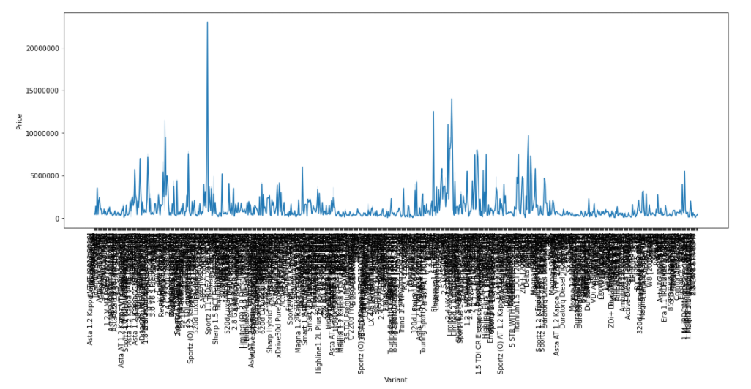
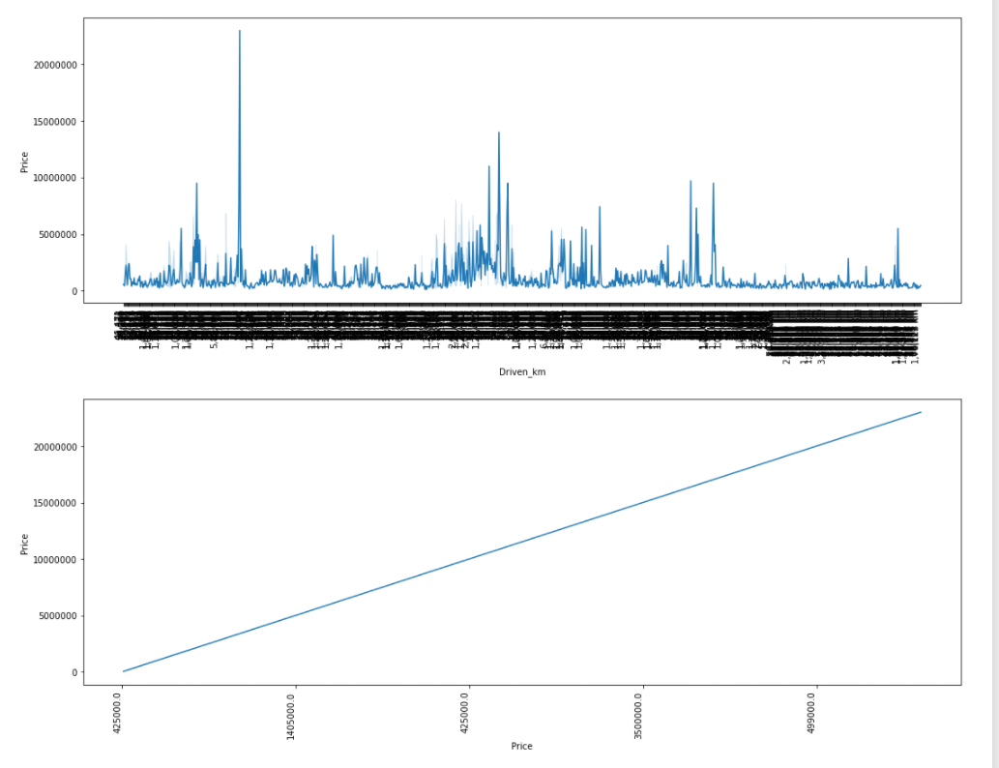

Slide 28
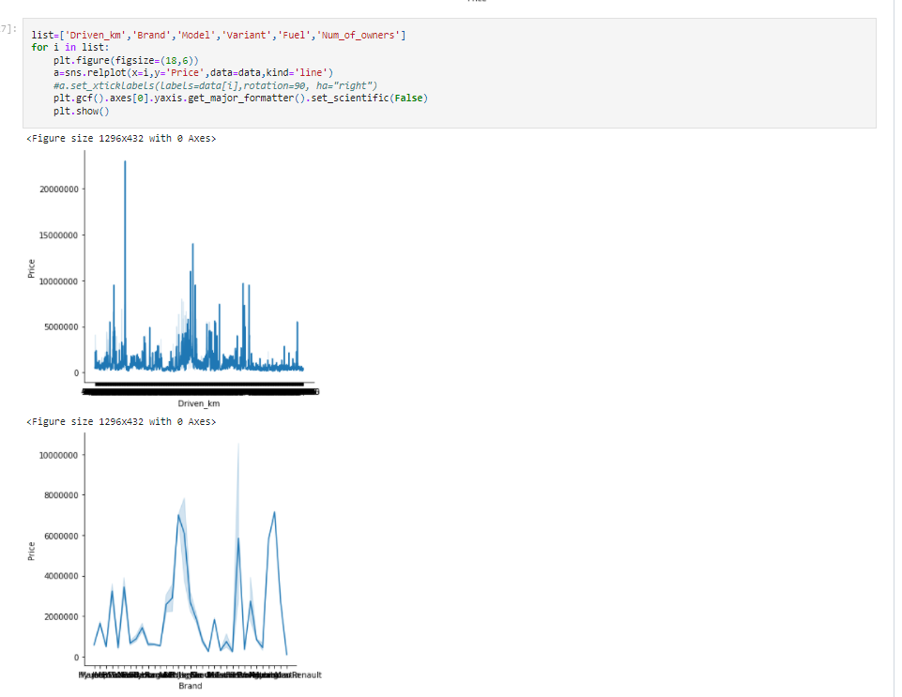

Slide 29
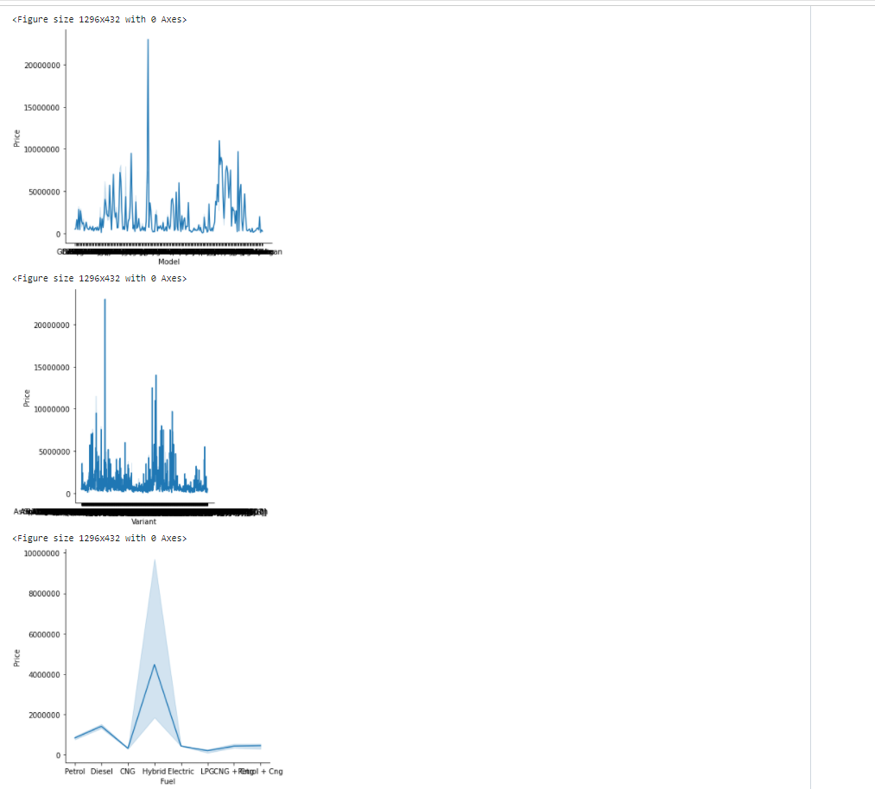

Slide 30
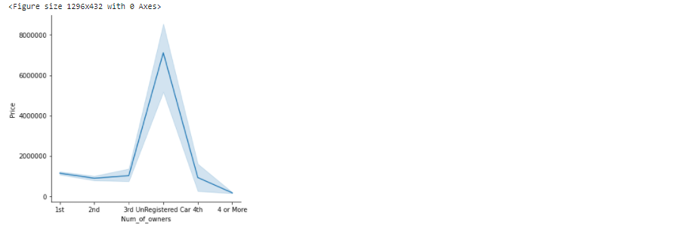
Maximum driven vehicles are for price less than 5000000.
Highest total of price Maruti Suzuki.
Maximum vehicles prices for models are with price less than 1000000.
Maximum vehicles prices for variants are with price less than 5000000.
Maximum vehicles prices for fuel are less with price than 100000.
Maximum vehicles for number of owners are with price less than 400000.

Slide 31
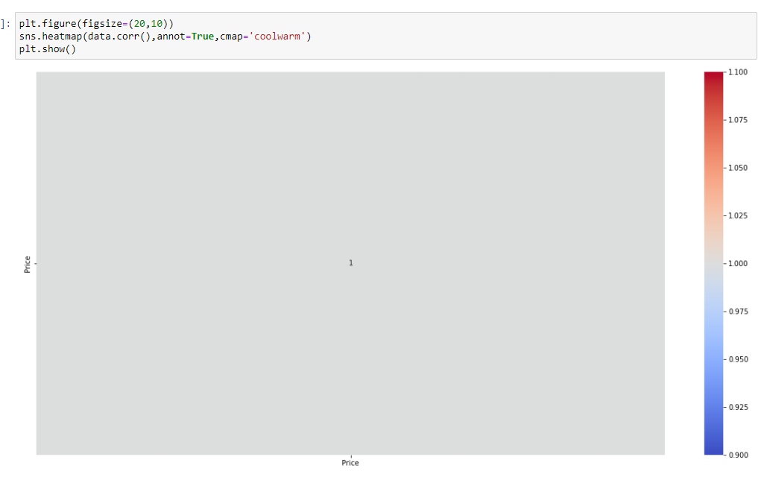
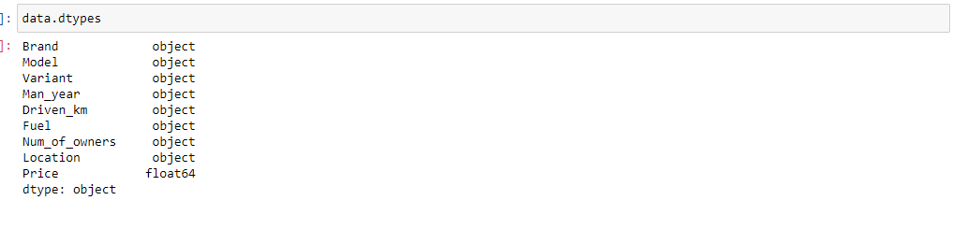
Let's Check the correlation now:
Let's change the data type of other object type columns.

Slide 32
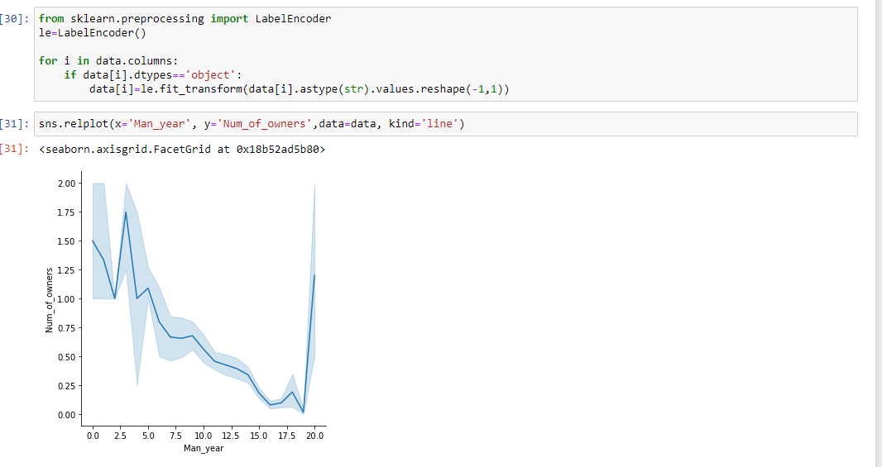
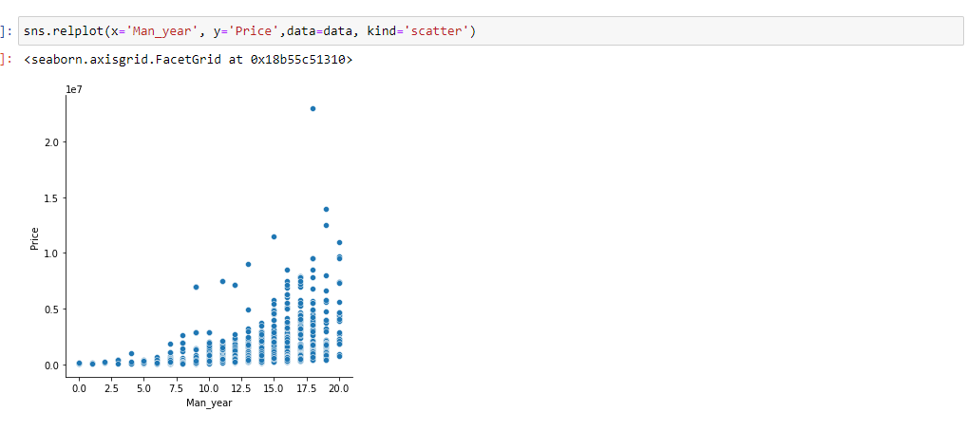
Encoding:
:
Num_of_owners.We can see negative relation between Man_year and Num_of_owners.
Num_of_owners.We can see positive relation between Man_year and Price.

Slide 33
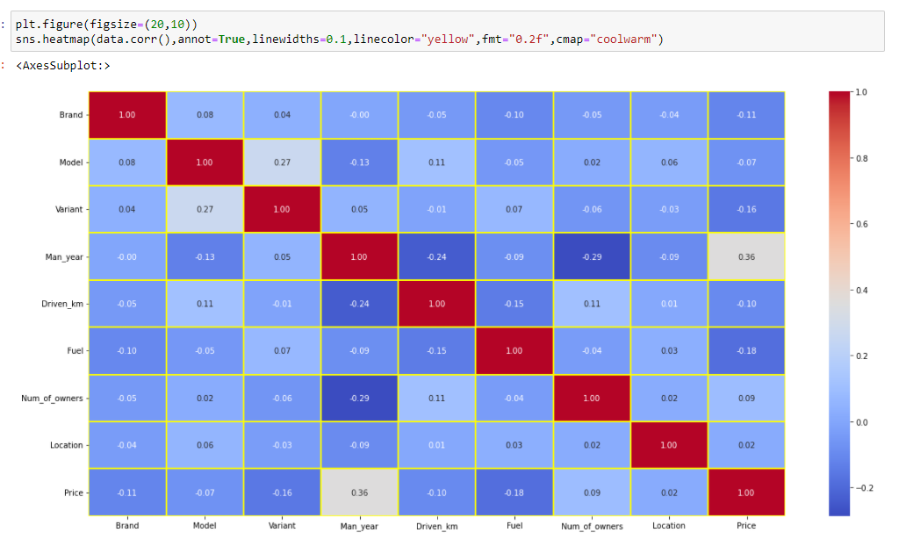
Checking the columns which are positively and negative correlated with the target columns:

Slide 34
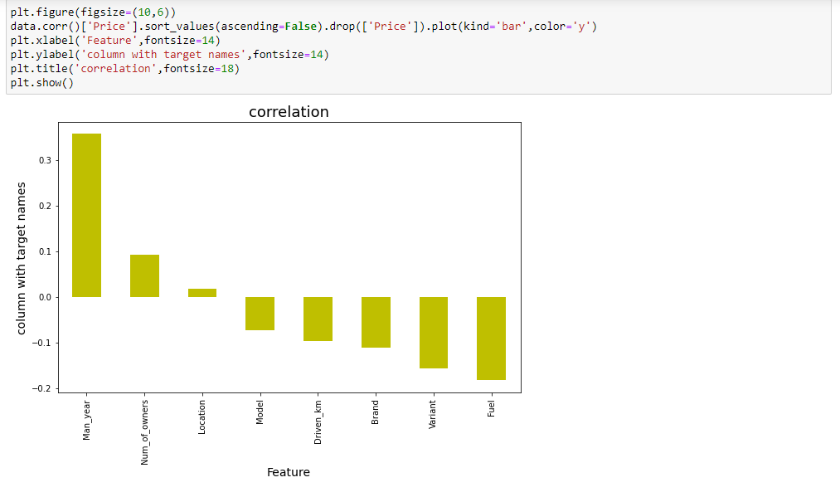
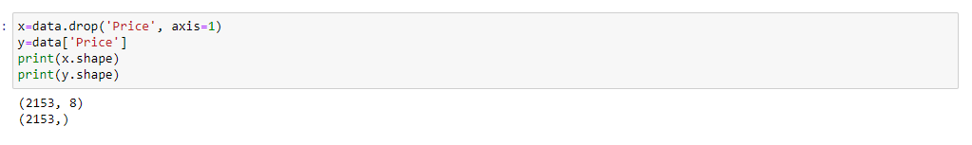
Other than price all other columns object type hence Skewness and outliers removal is not required.
Our target column Price is positively correlated with Man_year and has negative correlation with Fuel column..

Slide 35
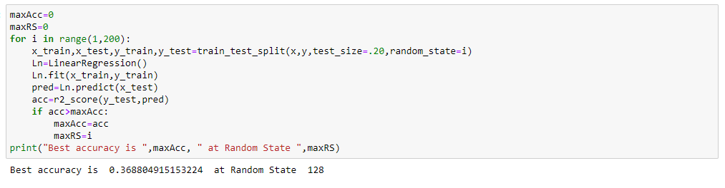
Model/s Development and Evaluation
Finding best random state:

Slide 36
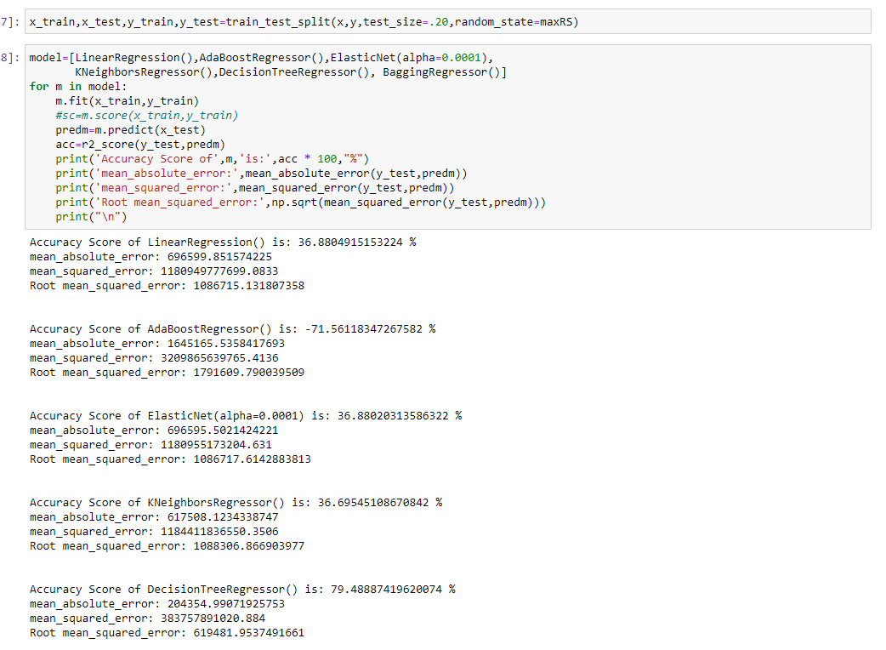
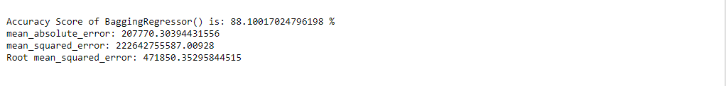
Heighest Accurecy is BaggingRegressor which is 88.10%

Slide 37
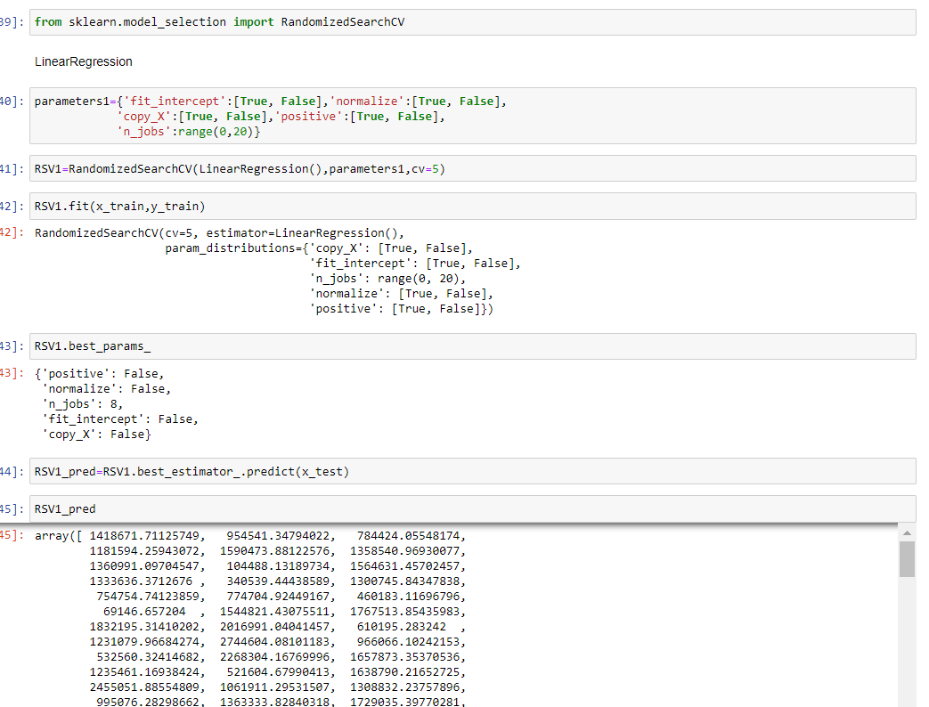
Hyper paramet Tunning:

Slide 38
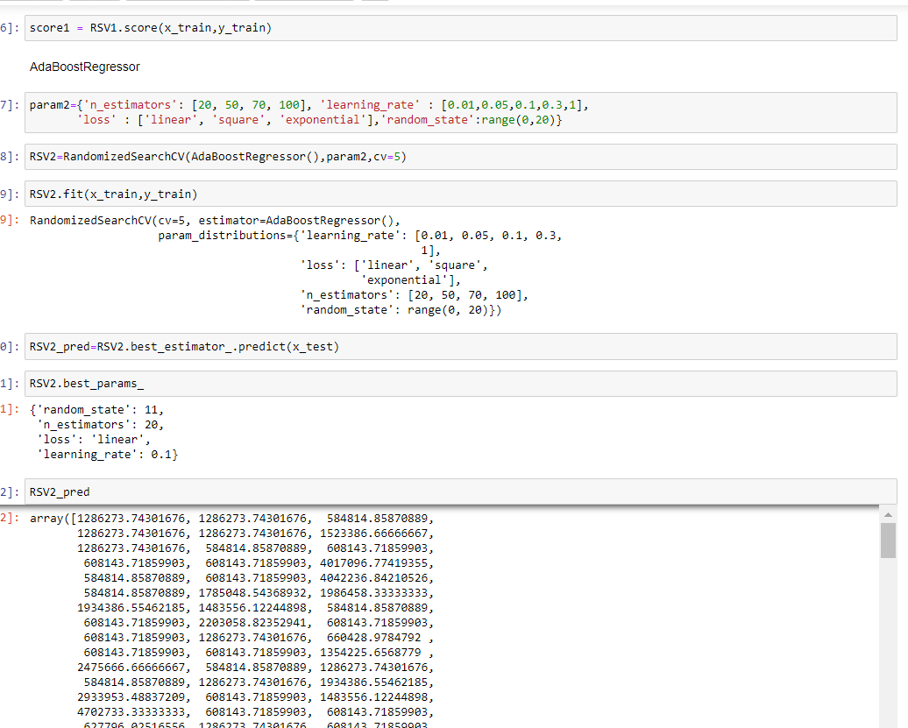

Slide 39
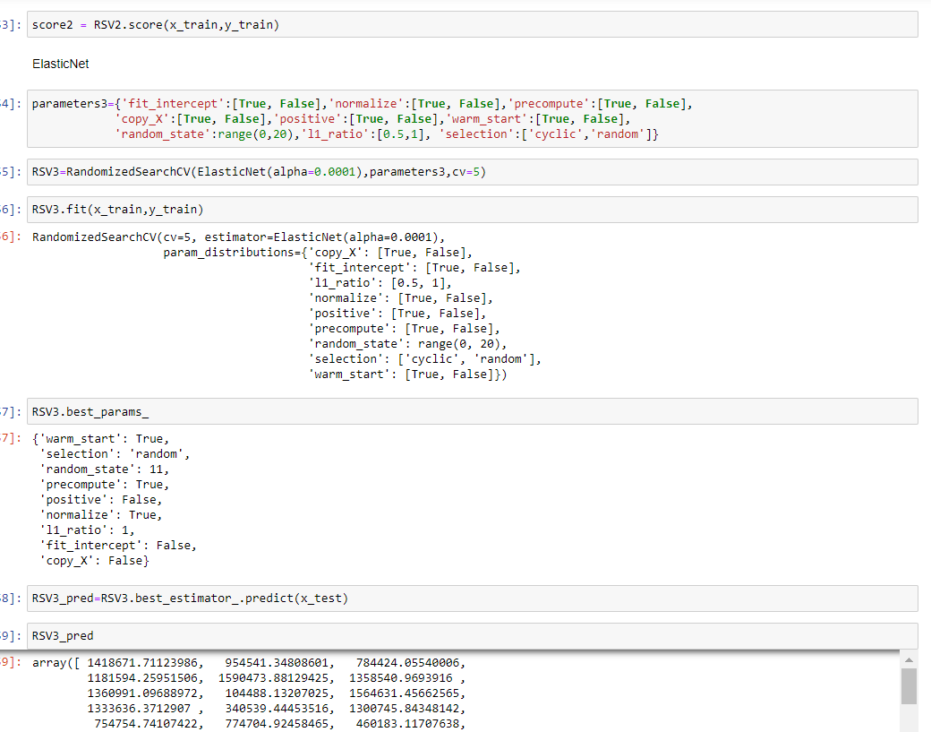

Slide 40
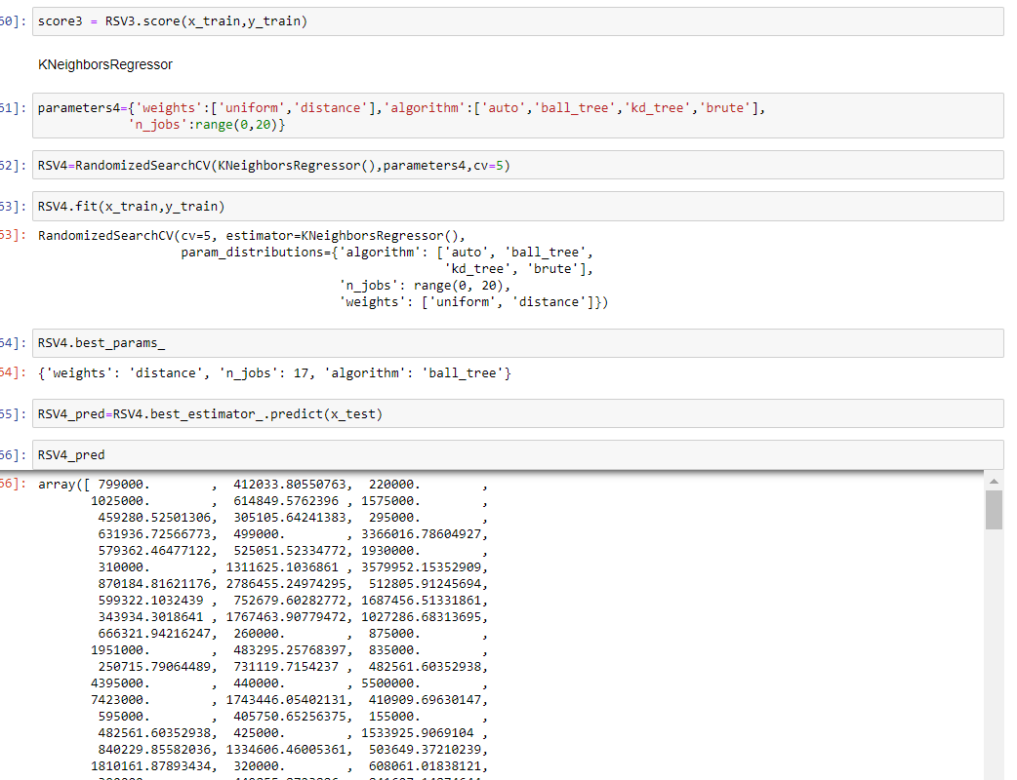

Slide 41
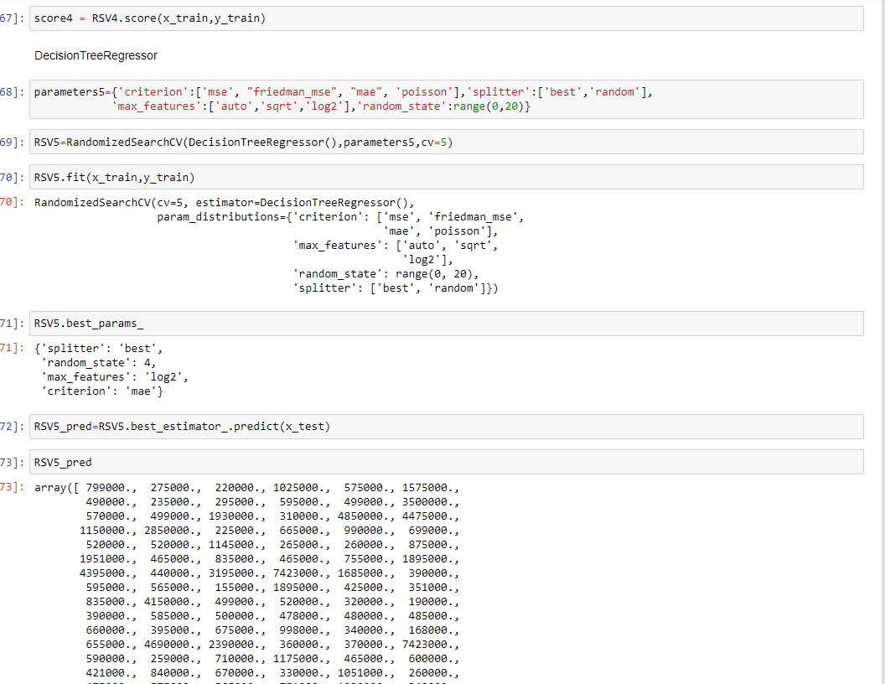

Slide 42
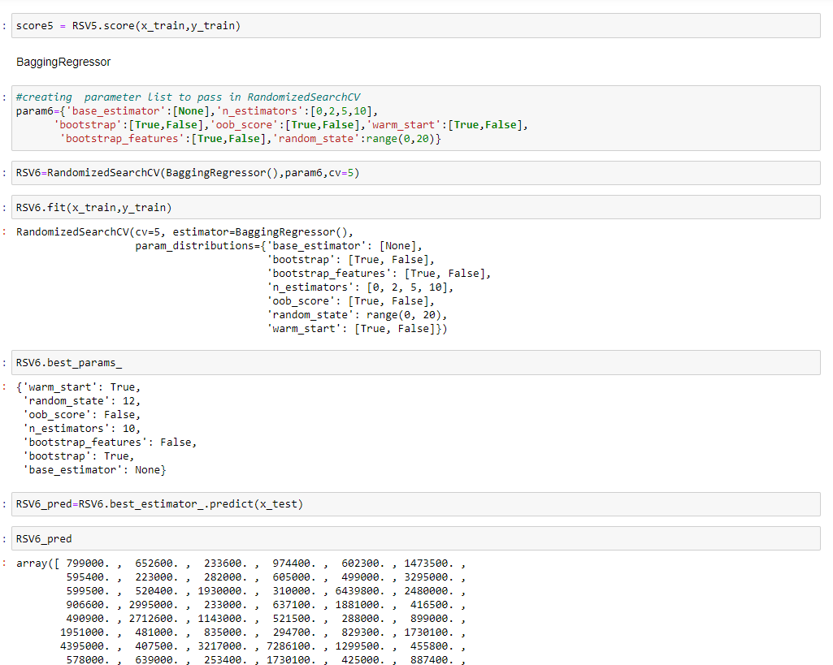

After performing RandomizedSearchCV method accuracy:

Slide 43

Selecting KNeighborsRegressor as final model for saving, as it was having good accuracy with model as well.

Slide 44

Savings The Best Model:

Slide 45
CONCLUSION
In the Car Price Prediction, I have extracted Brand, model, variant, manufacturing year, driven kilometers, fuel, number of owners, location and at last target variable Price of the car from different websites then saved the extracted csv file into one excel sheet. Our dataset mainly consists of 10 columns and 4810 rows. We have one column named Unnamed: 0 however that is not required for further analysis.
Then I did some preprocessing like dropping replacing ‘-‘ with NA , Converted price column into numeric, removed alphabetes from Driven_km and Man_year and then removed duplication of values. Then I have performed some visualization. After encoding object type variables, we have check for correlation.
Trying finding out best random random state and then used same for model building. Used 6 methods for model building then with the help of RandomizedSearchCV I have tried to improve accuracy. Finally, I decided to go ahead with the KNeighborsRegressor and saved the model.

Slide 46

THANK YOU!
ARGHA KR MAITI
Email
arghacrj17@gmail.com

